Slide 1
Tethered Control of UAV
Building a Platform for Tethered Control of UAV’s
BSc. Project Peter J. Savnik Advisor: Søren Hansen Jens C. Andersen

Slide 2
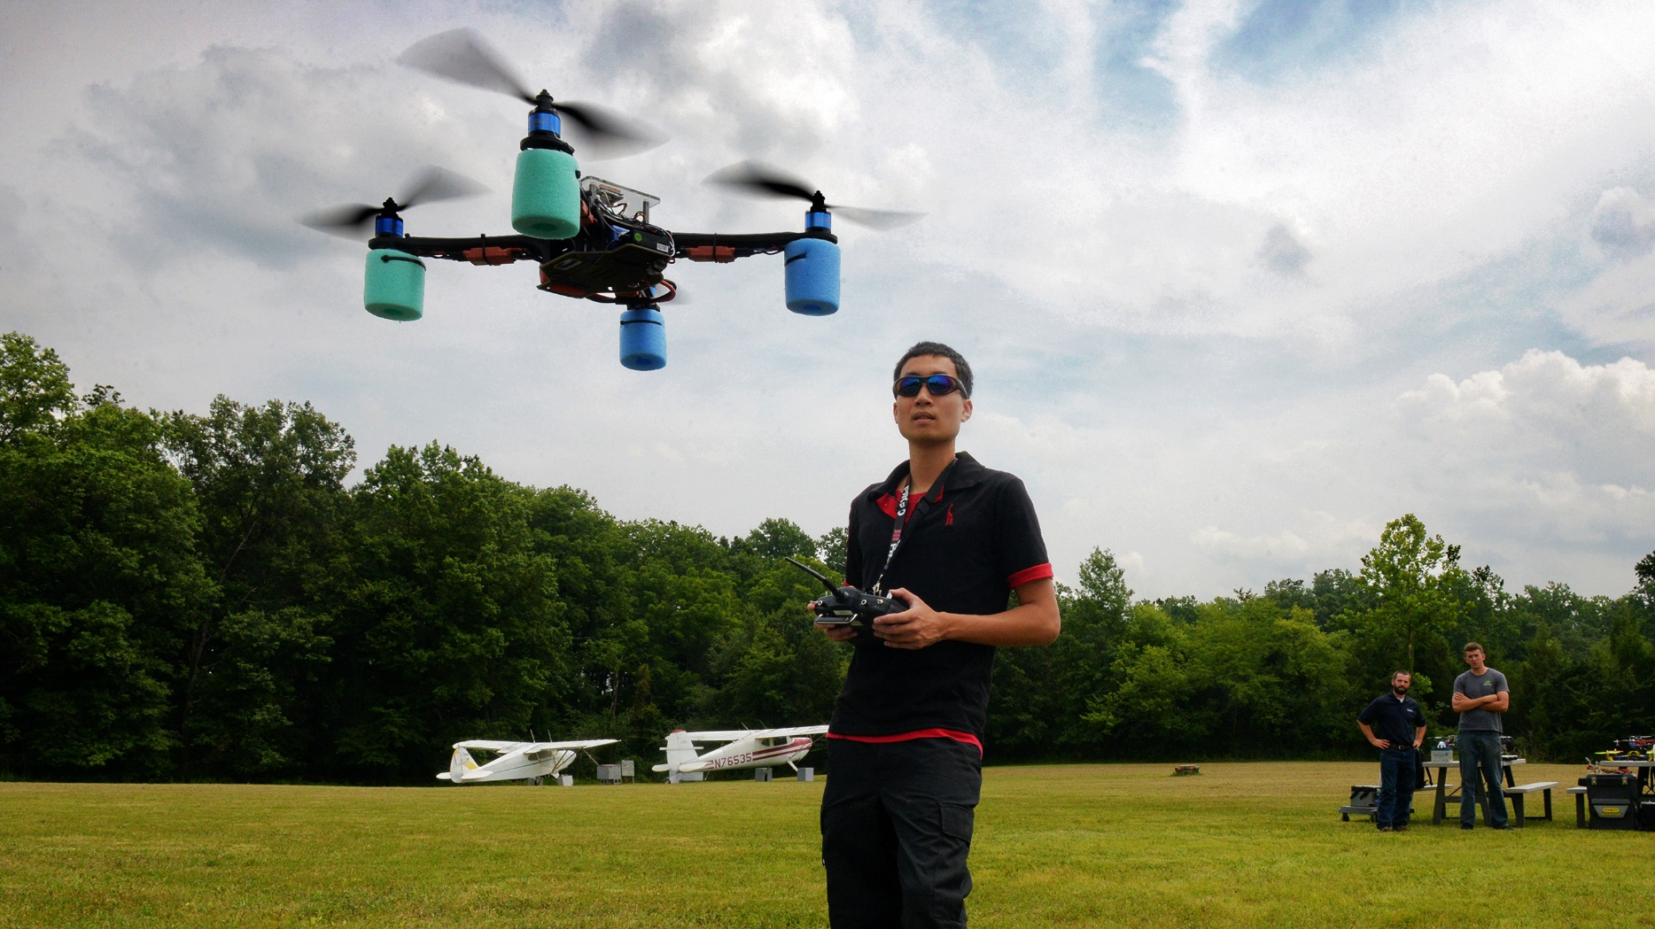
Hobby/Research » Industrial Application
Add Presentation Title in Footer via ”Insert”; ”Header & Footer”
Notes:
A few years back small UAV’s, like this one, has only been available for research and hobby enthusiasts.
But lately it has been implemented in a range of industrial applications.

Slide 3
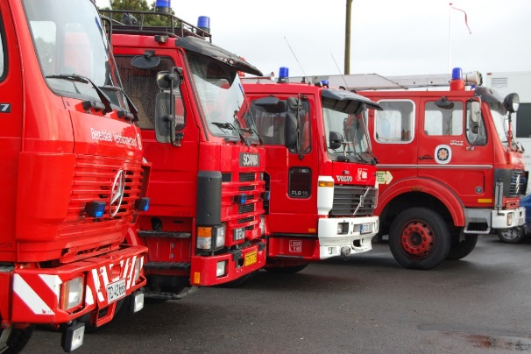
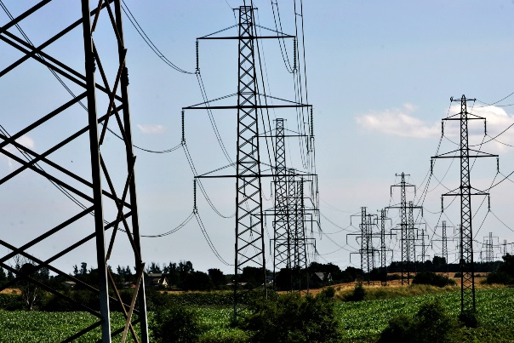
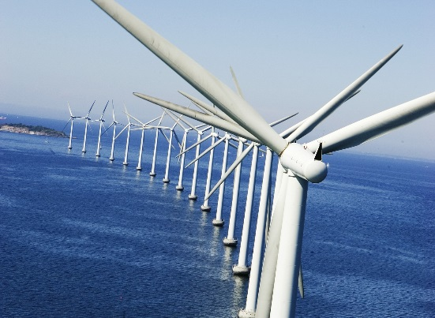
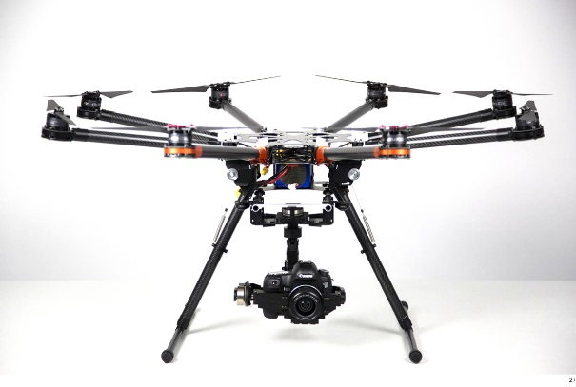
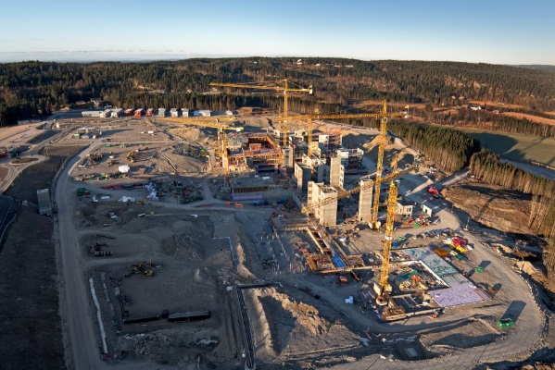
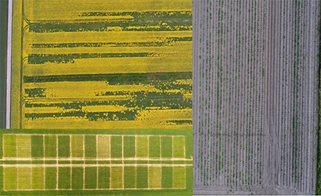
Industrial Applications
Exsampels on UAV’s implemented in an Industrial Application.
Notes:
Today drones are already implementet in firefigthing, inspection af power supply cables, windmills, construction site and farming.

Slide 4
Common Problem
Power Supply
Brand | Flight time
DJI Phantome II | 20 min
S1000 | 15 min
3DR RTF X8 | 12-13 min
ARF OktoXL 6S12 | 8-25 min
Comparing flight time for 4 Industrial UAV’s.
Notes:
A common problem for drones are the very short flight time.
All 4 drones are sold in industrial applications.
As we can see flight time is not impressing.

Slide 5
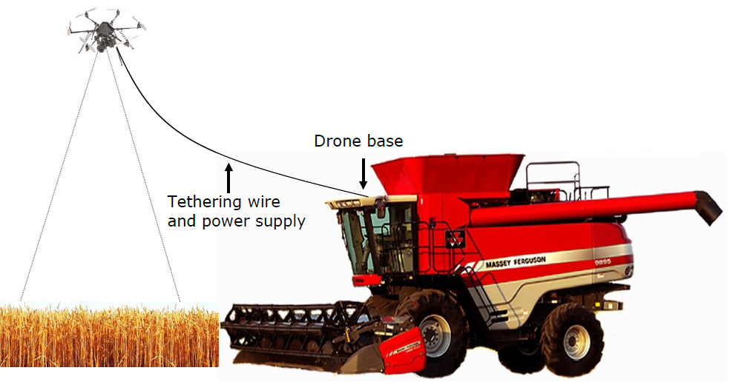
PTC - Platform for Tethered Control of UAV’s
Supply UAV with 120VDC@4.6A ~500W through a cable.
Loss in cable
Modeling the physics
Cartenary Chain
Thermodynamics
Design a practical solution
How to roll cable in/out
Storing of cable
Implement and test
Test designs and compare
Notes:
Outline of what i want to do with this thesis.

Slide 6
Roadmap
Analysis
Design
Implementation
Test & Quality Control
Analyze Results
Milestones
3/10 Work Breakdown Structure
10/10 Propose Design solution
24/11 Testing and Implementation done
23/1 Hand in Thesis

